Slide 1

SAI VIDYA INSTITUTE OF TECHNOLOGY
Department of Computer Science and Engineering
Rajanukunte, Bengaluru - 560064
Web Technology Laboratory with Mini Project (17CSL77)
WIN WALK
By
Rakesh M R 1VA17CS040
B G Vinayak 1VA17CS010
Under the guidance of
Mr. Nagamahesh B S
Assistant Professor
Dept. of CSE, SVIT

Slide 2
Presentation Outline
Introduction
System Requirement Specification
System Architecture
Snapshots
Conclusion
References
Dept. of CSE, SVIT ‹#›

Slide 3
Introduction
Fitness is certainly a solo phenomenon, however, efficiency and consistency are increased ten-folds when it has a sense of community. The community provides us a sense of belonging which keeps us motivated to achieve personal fitness goals.
This soul reason brought us the idea of creating a community of people who share a common interest in physical fitness and mental health. We live in an era of absolute uncertainty. What we can promise ourselves is a healthy life. Just taking 30 min of our time out today to be fit is all it takes to build a strong and healthy tomorrow.
WinWalk is a web based project. This project aims to build an online community, to collaborate with like minded people and to create awareness about physical and mental health.
Dept. of CSE, SVIT ‹#›

Slide 4
System Requirement Specification
SOFTWARE REQUIREMENTS
Programming language : PHP, MYSQL
Operating system : ANY OS (Recommended: Windows 8, Windows 10)
Application required : Standalone desktop application & Xampp
Coding language : PHP, HTML, CSS, Javascript.
HARDWARE REQUIREMENTS
CPU : Pentium IV 2.4 GHz or above
Memory (Primary) : 512 MB, 1 GB or above
Hard Disk : 40 GB or above
Monitor : 15 VGA color
Dept. of CSE, SVIT ‹#›

Slide 5
System Requirement Specification
FUNCTIONAL REQUIREMENTS
• Login interface (Admin & User)
• Comment feature
• Messaging feature
• UI friendly admin dashboard
• Fully dynamic & responsive website
• Searching posts with keyword
NON-FUNCTIONAL REQUIREMENTS
• Usability
• Security
• Reliability
Dept. of CSE, SVIT ‹#›

Slide 6
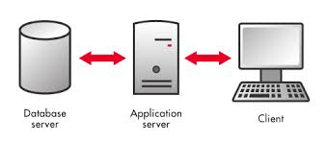
System Architecture
Dept. of CSE, SVIT ‹#›

Slide 7
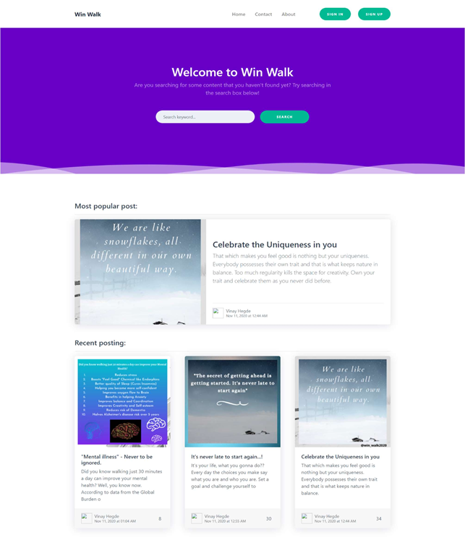
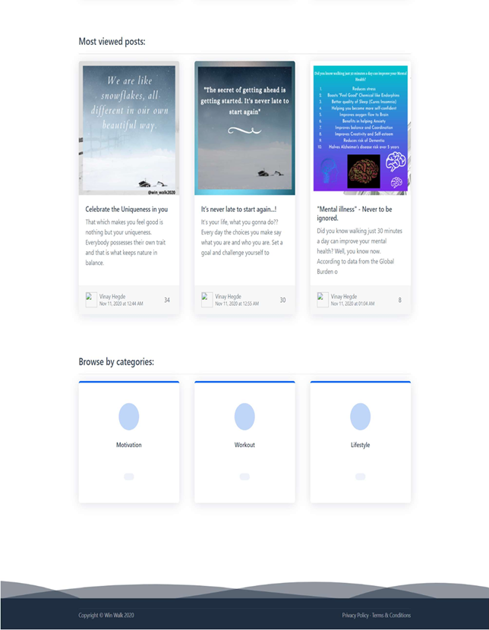
Snapshots
Dept. of CSE, SVIT ‹#›

Slide 8
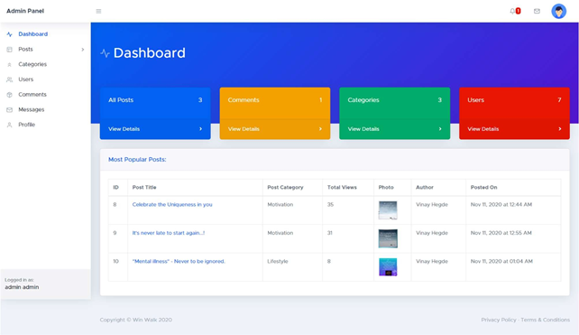
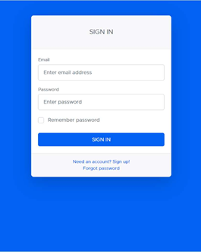
Snapshots
Dept. of CSE, SVIT ‹#›

Slide 9
Conclusion
The website provides a rich user interface to allow the users to have a great user experience.
For implementing this system, PHP, HTML, CSS, JavaScript and MySQL are used.
The system comprises of following features:
User signup/ login.
Commenting, messaging feature.
Showing the posts by recent posts, most viewed and by categories.
Below list shows the future points to be considered:
Implementing an option to share the posts on any social media.
Making it more versatile, so that registered user can also share their posts.
Notification for user on post posted by admin.
Dept. of CSE, SVIT ‹#›

Slide 10
References
[1] www.w3schools.com
[2] developer.mozilla.org
[3] www.stackoverflow.com
[4] www.coursera.org
[5] www.youtube.com
[6] www.wikipedia.org
[7] www.udemy.com
Dept. of CSE, SVIT ‹#›

